Slide 1


Mastering Flutter: From Beginner to Pro.
joeshwoa.george@gmail.com
Session 7: Dart Syntax Basics

Slide 2
Do not skip any information without understanding it.
joeshwoa.george@gmail.com
― Joeshwoa George

Slide 3
Any questions?
joeshwoa.george@gmail.com
Don;t forget study this section well and write your questions in note and i will answer it in live session.

Slide 4
Table of Contents.
Functions in Dart
Collections in Dart
Control Flow
Q&A and Wrap-Up
01
02
Functions, Parameters, Return Values, Arrow Functions.
Lists, Sets, Maps.
03
04
Conditionals, Loops, Switch-Case.
Let's ask
joeshwoa.george@gmail.com

Slide 5
Functions in Dart.
01
Let’s Start with
Functions
joeshwoa.george@gmail.com

Slide 6
Introduction to Dart
Dart is a modern, object-oriented programming language developed by Google.
Primarily used for building Flutter apps.
Strongly typed with support for both static and dynamic typing.
Null safety to reduce runtime errors.
Easy-to-learn syntax inspired by Java, C++, and JavaScript.
joeshwoa.george@gmail.com

Slide 7
Basic Syntax
Dart programs start execution from the main() function.
void main() {
print("Hello, Dart!");
}
joeshwoa.george@gmail.com

Slide 8
Comments
Single-line:
Multi-line:
// This is a single-line comment
joeshwoa.george@gmail.com
/*
This is a multi-line comment.
*/

Slide 9
Variables and Data Types
Declaring variables with types or using var.
Using final and const for immutable variables.
int age = 25;
var name = "Alice"; // Type inferred as String
joeshwoa.george@gmail.com
final city = "Cairo";
const pi = 3.14159;

Slide 10
Variables and Data Types
Null safety: Use ? for nullable variables.
String? nullableName;
joeshwoa.george@gmail.com

Slide 11
Defining Functions
void greet() {
print("Hello, World!");
}
Positional parameters:
void greet(String name) {
print("Hello, $name!");
}
joeshwoa.george@gmail.com

Slide 12
Defining Functions
Optional named parameters:
void greet({String? name}) {
print("Hello, ${name ?? 'Guest'}!");
}
joeshwoa.george@gmail.com

Slide 13
Return Values
int add(int a, int b) {
return a + b;
}
joeshwoa.george@gmail.com

Slide 14
Arrow Functions
int square(int x) => x * x;
joeshwoa.george@gmail.com

Slide 15
Collections in Dart.
02
Let’s Start with
Lists
joeshwoa.george@gmail.com

Slide 16
Lists
Mutable:
Immutable:
List<int> numbers = [1, 2, 3];
numbers.add(4);
print(numbers); // [1, 2, 3, 4]
joeshwoa.george@gmail.com
var immutableList = const [1, 2, 3];

Slide 17
Sets
Unique elements:
Set<String> fruits = {"Apple", "Banana", "Apple"};
print(fruits); // {Apple, Banana}
joeshwoa.george@gmail.com

Slide 18
Maps
Key-value pairs:
Map<String, int> scores = {"Alice": 90, "Bob": 80};
print(scores["Alice"]); // 90
joeshwoa.george@gmail.com

Slide 19
Control Flow.
03
Let’s Start with
Conditionals
joeshwoa.george@gmail.com

Slide 20
if-else
int age = 20;
if (age >= 18) {
print("You are an adult.");
} else {
print("You are a minor.");
}
joeshwoa.george@gmail.com

Slide 21
Ternary operator
String message = (age >= 18) ? "Adult" : "Minor";
joeshwoa.george@gmail.com

Slide 22
For loop
for (int i = 0; i < 5; i++) {
print("Count: $i");
}
joeshwoa.george@gmail.com

Slide 23
While loop
int counter = 0;
while (counter < 3) {
print("Counter: $counter");
counter++;
}
joeshwoa.george@gmail.com

Slide 24
For-each loop
List<String> names = ["Alice", "Bob", "Charlie"];
for (var name in names) {
print(name);
}
joeshwoa.george@gmail.com

Slide 25
Switch-Case
String day = "Monday";
switch (day) {
case "Monday":
print("Start of the work week!");
break;
case "Friday":
print("Almost weekend!");
break;
default:
print("Just another day.");
}
joeshwoa.george@gmail.com

Slide 26
Q&A and Wrap-Up.
04
Let’s Start with
Any questions in this session?
joeshwoa.george@gmail.com

Slide 27
Homework
Write a function to calculate the factorial of a number using a for loop.
Implement a program that takes a map of students and their scores. Use a loop to print only the names of students who scored above 80.
joeshwoa.george@gmail.com

Slide 28
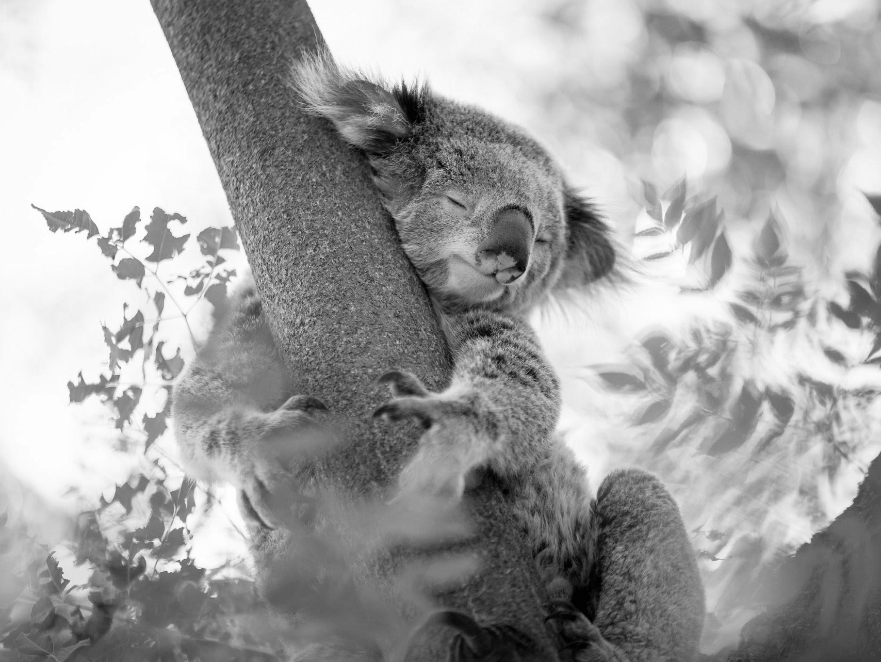
OFFFFF Take a brack.
joeshwoa.george@gmail.com
Only Koalas don’t have much energy and, Koala can sleep for up to 18 hours a day but you only need 6-8 hours to have all energy needed energy for one day.

Slide 29
So, Don’t Wast Your Time in Sleep.
joeshwoa.george@gmail.com
― Joeshwoa George

Slide 30
See you next session!
joeshwoa.george@gmail.com
Don;t forget study this section well and write your questions in note and i will answer it in live session.

Slide 31

Thank you!
Do you have any questions?
joeshwoa.george@gmail.com
+20 120 294 6596
joeshwoa.george@gmail.com

